Slide 1
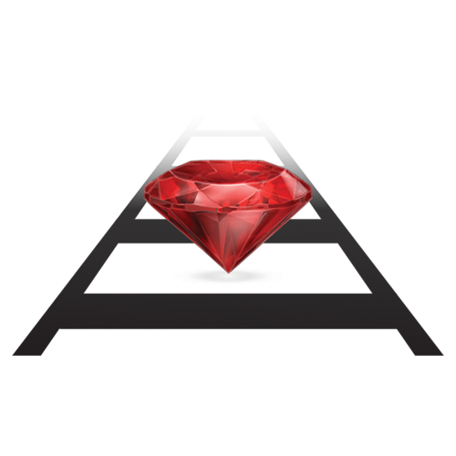
Building Application With Ruby On Rails Framework
View Ruby On Rails course details at www.edureka.co/ruby-on-rails
For Queries:
Post on Twitter @edurekaIN: #askEdureka
Post on Facebook /edurekaIN
For more details please contact us:
US : 1800 275 9730 (toll free)
INDIA : +91 88808 62004
Email us : webinars@edureka.co

Slide 2





What will you learn today?
Introduction to Ruby on Rails Framework
Features of Ruby on Rails
MVC Architecture
Building Rails Application

Slide 3





9 Reasons Why You Should Learn Ruby
It is easy to learn
Saves time by writing more with less
Create web apps quickly and with ease
It is free of charge
Ruby can be customized

Slide 4





9 Reasons Why You Should Learn Ruby (Contd.)
It is Portable
Learning Ruby helps you get a job
DSL
The community will help www.rubyonrails.org/community
Make your own Domain Specific Language

Slide 5

Ruby on Rails
Ruby is an Object Oriented Programming language
Ruby has simple English like syntax
Using Ruby you will write less code
Ruby on Rails is a full-stack framework
Used to developing web applications
It is working under the Model-View-Control pattern
It is an open source framework
Ruby on Rails framework is familiar for
Simplicity
Productivity
Speed of development
Reliable Solutions

Slide 6





Examples of Application built on Ruby on Rails

Slide 7
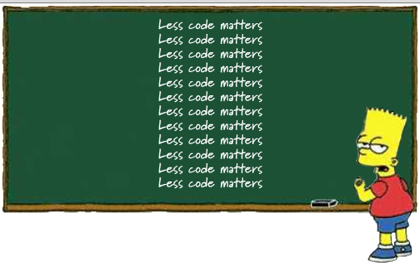
Rails Golden Rule 1 : DRY
DRY just means "Don't Repeat Yourself". Make sure that when you write code, you only write it one time.
The DRY principle is stated as "Every piece of knowledge must have a single, unambiguous, authoritative representation within a system."
Reference: https://maurits.wordpress.com

Slide 8

Rails Golden Rule 2 : Convention Over Configuration
Convention over configuration (also known as coding by convention) is a software design paradigm which seeks to :
For example, if there is a class Sale in the model, the corresponding table in the database is called "sales" by default. It is only if one deviates from this convention, such as calling the table "product sales", that one needs to write code regarding these names.
Decrease number of decisions on developers
Gain Simplicity
Not losing flexibility

Slide 9
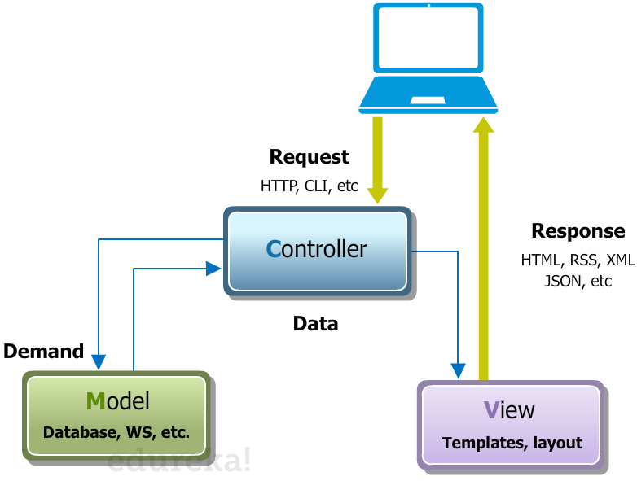
Rails MVC Architecture

Slide 10
Creating a Rails Application
Rails application can be created using the following command
>rails new app_name
When you create an application using the rails helper script, you can see that a new directly structure is created for your application. The directory structure will have to following directories that will be explained in the next slide.

Slide 11
Directory Layout
File /Folder | Purpose
app/ | Contains the controllers, models, views, helpers, mailers and assets for your application.
bin/ | Contains the rails script that starts your app and can contain other scripts you use to deploy or run your application.
config/ | Configure your application's routes, database, and more
condig.ru | Rack configuration for Rack based servers used to start the application.
db/ | Contains your current database schema, as well as the database migrations
Gemfile Gemfile.lock | These files allow you to specify what gem dependencies are needed for your Rails application. These files are used by the Bundler gem.
Lib/ | Extended modules for you application
Log/ | Application log files

Slide 12
Directory Layout (Contd.)
File /Folder | Purpose
public/ | The only folder seen by the world as-is. Contains static files and compiled assets.
Rakefile | This file locates and loads tasks that can be run from the command line. Rather than changing Rakefile, you should add your own tasks by adding files to the lib/tasks directory of your application
README.rdoc | This is a brief instruction manual for your application. You should edit this file to tell others what your application does, how to set it up, and so on.
test/ | Unit tests, fixtures, and other test apparatus.
tmp/ | Temporary files (like cache, pid, and session files).
Vendor/ | A place for all third-party code. In a typical Rails application this includes vendor’s gems.

Slide 13
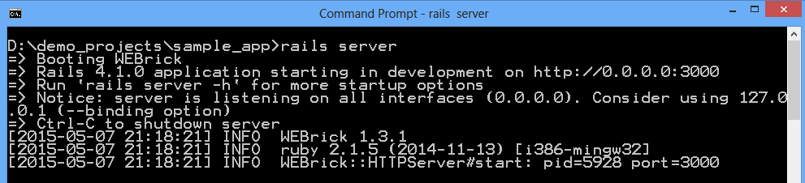
Running Rails Application
Rails application can be booted using the following command
>rails server
This command will fire up WEBrick, a web server distributed with Ruby.
Default environment is development
Default port is 3000
http://127.0.0.1:3000

Slide 14
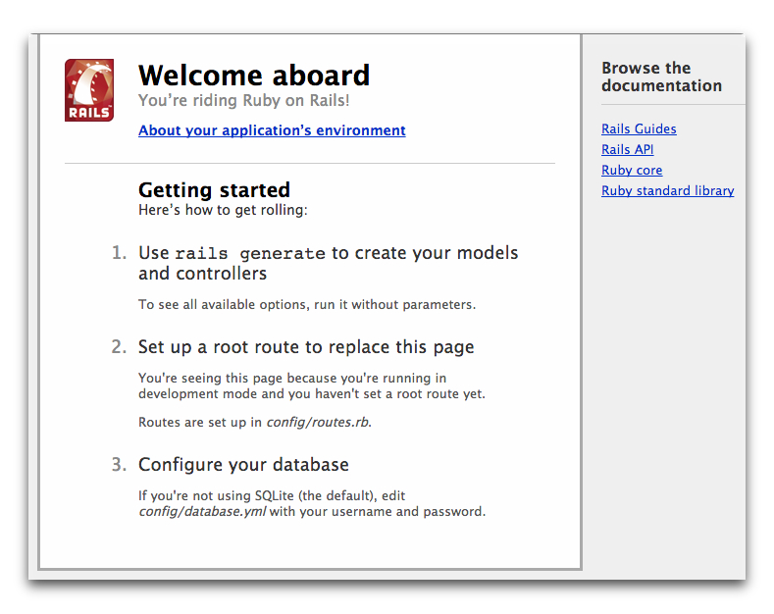
Running Rails Application (Contd.)
To see your application in action, open a browser window and navigate to http://localhost:3000

Slide 15
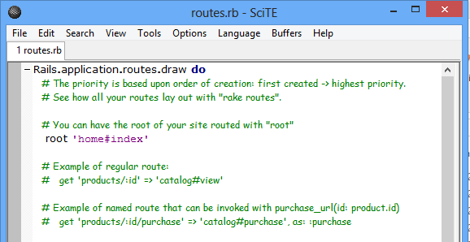
Creating Rails Views and Controller
Create first controller
>rails generate controller home
Create new file and store with name index.html.erb
>rails g controller home index
Add the content to index.html.erb file
<h1>Hello, Rails!</h1>
Open the file config/routes.rb in your editor. Remove the comment “#” and change root to
# root ‘home#index'

Slide 16
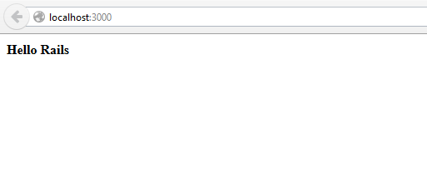
Creating Rails Views and Controller (Contd.)
Launch the web server again and navigate to http://localhost:3000 in your browser.

Slide 17

Certifications
Get certified in Ruby On Rails by Edureka
Go to www.edureka.co/ruby-on-rails
Batch starts from 24th October (Weekend)
Edureka's Ruby On Rails course:
It covers all the fundamental concepts of OOPS and Web Applications, Ruby scripting, MVC architecture to advanced topics like Gemified plugins, Application deployments, API conventions, cloud support by Heroku, Front End, and Back End DB collaborations etc.
It will enable learners to build web applications using the powerful Rails framework and the highly dynamic, object-oriented Ruby language. Participants will also get to implement one project towards the end of the course.
Online Live Courses: 30 hours
Assignments: 25 hours
Project: 20 hours
Lifetime Access + 24 X 7 Support

Slide 18
Thank You
Questions/Queries/Feedback
Recording and presentation will be made available to you within 24 hours

